Slide 1



Weekly Meeting
Liri Chen, Shuo Lin, Wenqi Sun, Zhexin Wang, Zixiao Zhang

Slide 2
Aligned Timeline
Time | Milestone | Status
Oct 3 - Oct 17 | Baseline, metrics | Done
Oct 18 - Oct 31 | Data Retrieval Optimization UI Design | Done
Nov 1 - Nov 21 | Prototype & demo(Search w/o GPT + WebApp) Data Retrieval Integration & Optimization | In Progress Static Backend is ready Section-based search almost done
Nov 22 - Nov 28 | Backend API & UI design
Nov 29 - Dec 16 | Final Presentation

Slide 3
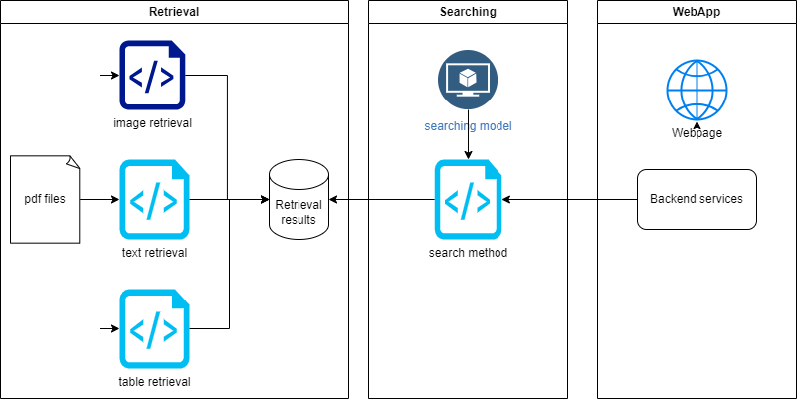
Architecture

Slide 4
Current design for second part
Stage 1
Users’ input: (year, company, keywords)
We match keywords with the text/table on each page using LLM
Return the content on the most relevant page
Stage 2
Users’ input: (year, company, any sentences or words)
We first find out the most relevant page(same as stage 1)
Then we try to return a portion of the page that is accurately related to the input

Slide 5
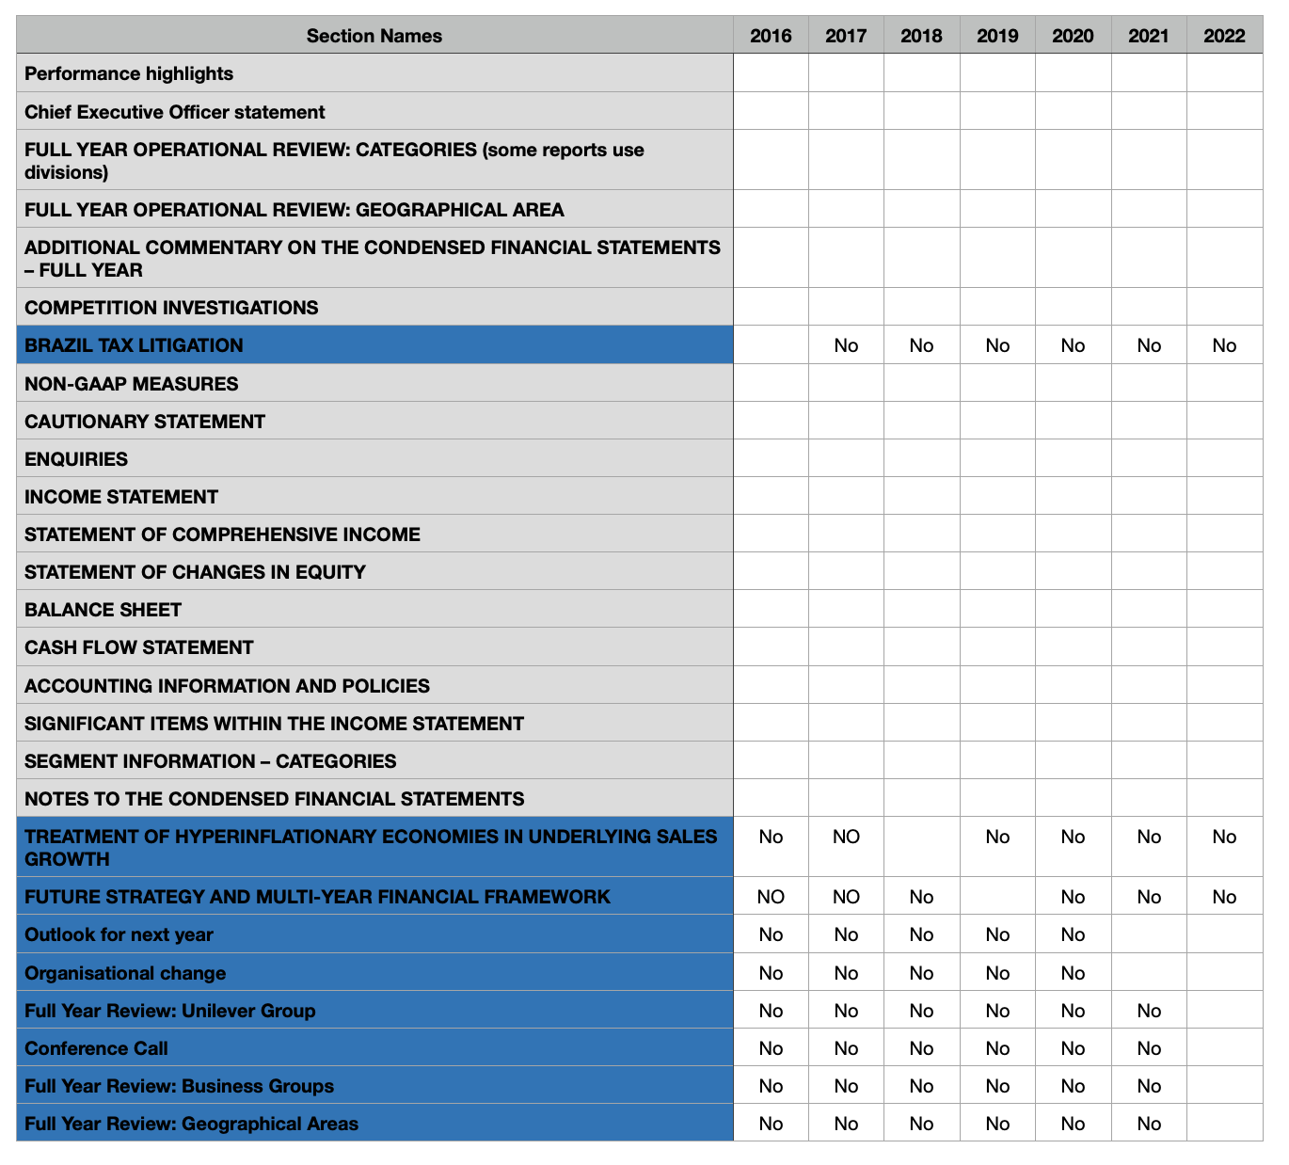
Sections
Inconsistency in sections
Variations in section names across different reports.

Slide 6
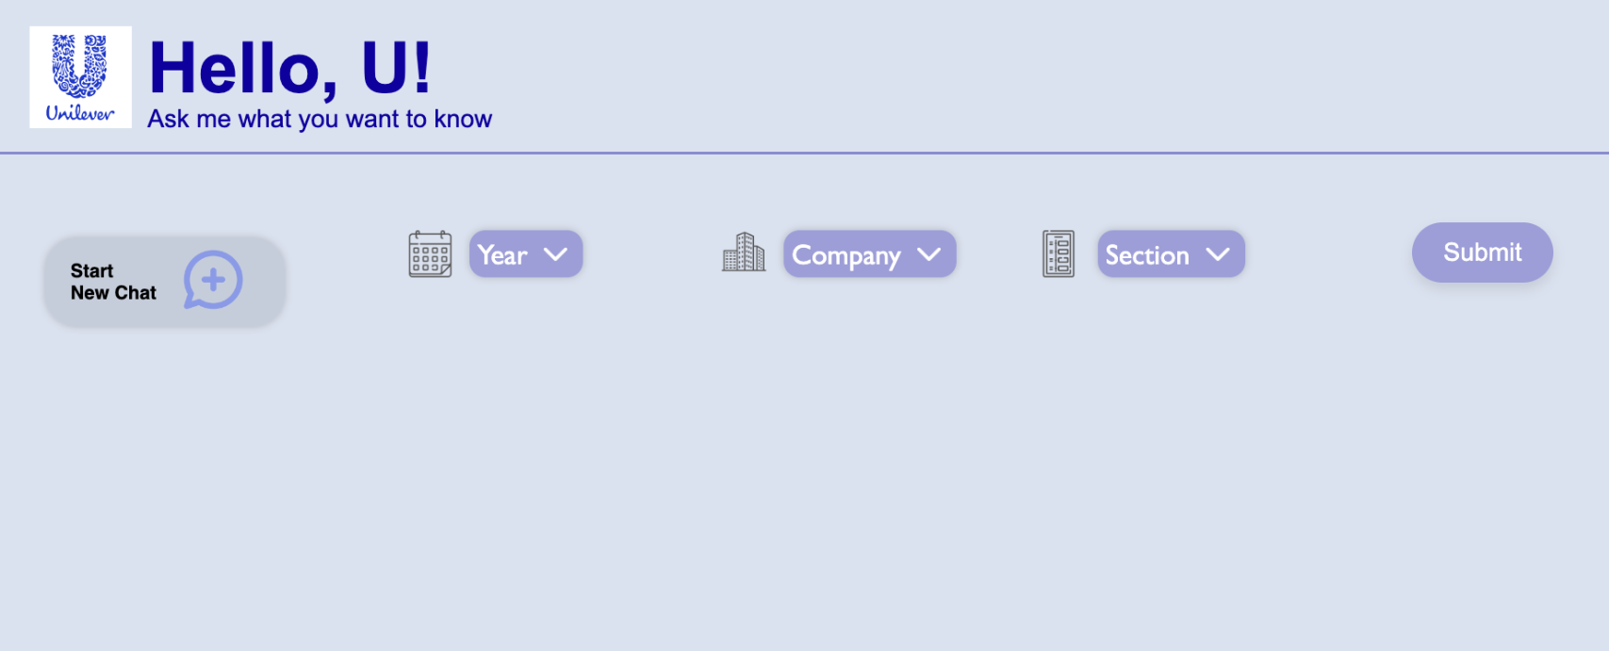
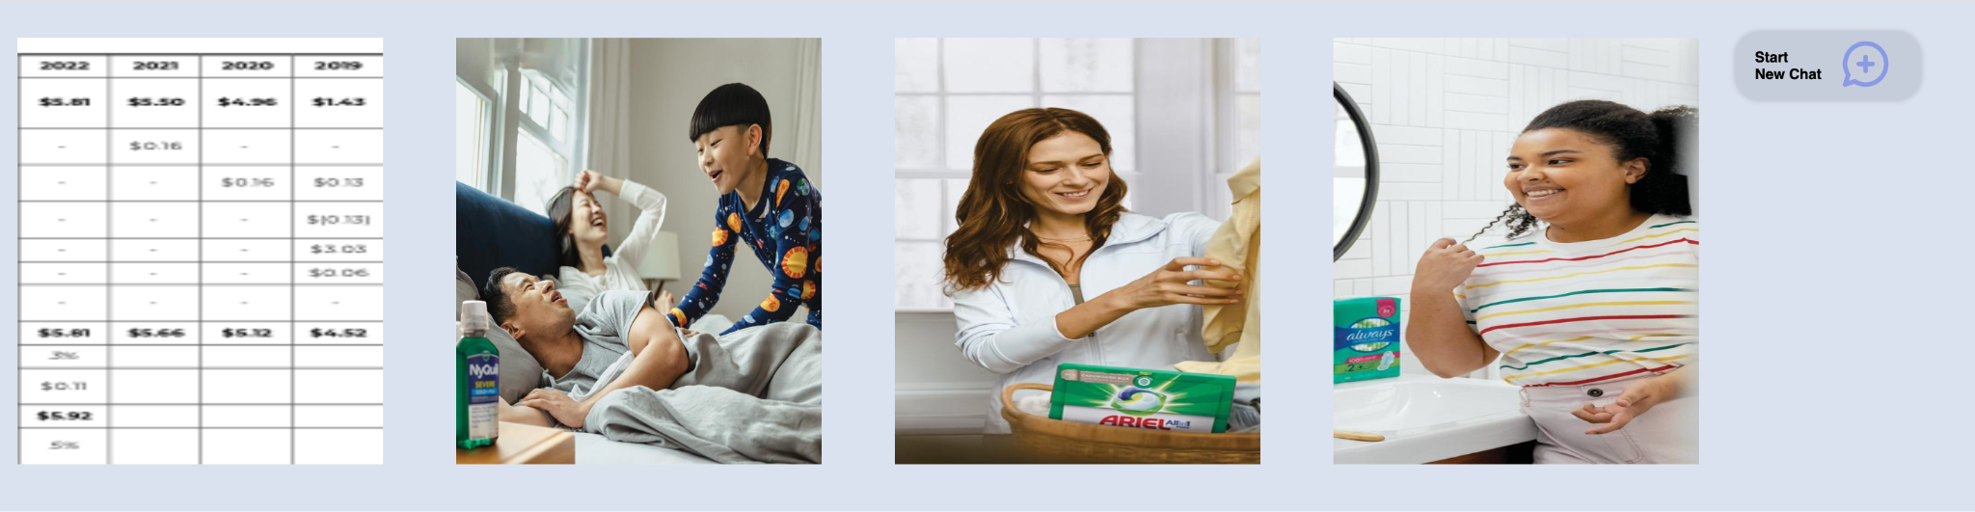
Web App
Current functionality:
Select Year, Company, and Section for data retrieval
Back-end locates files based on the page range of the section
Option to start new chat for queries

Slide 7
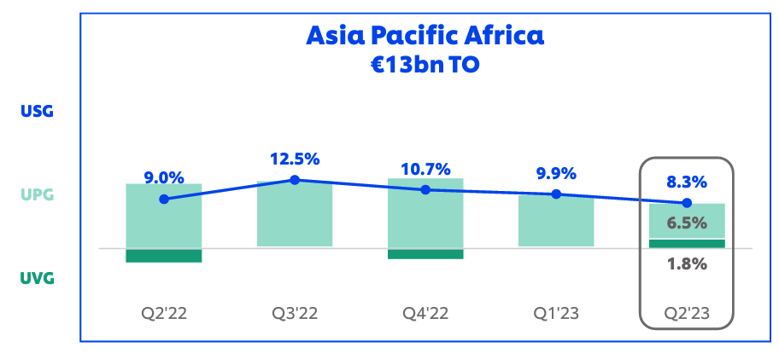
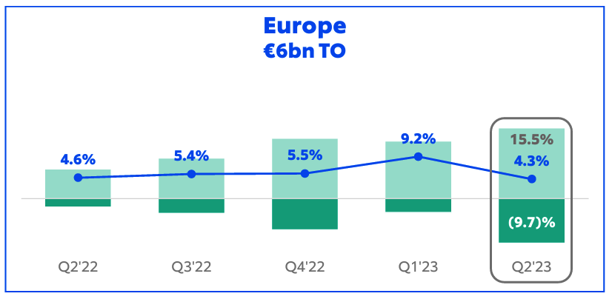
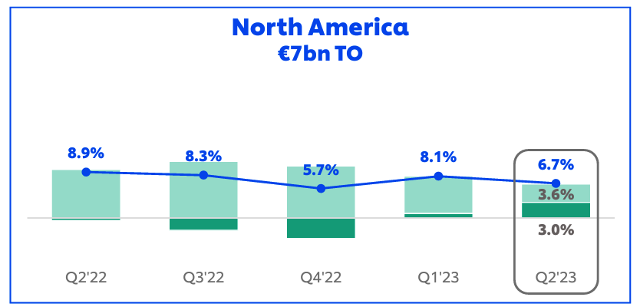
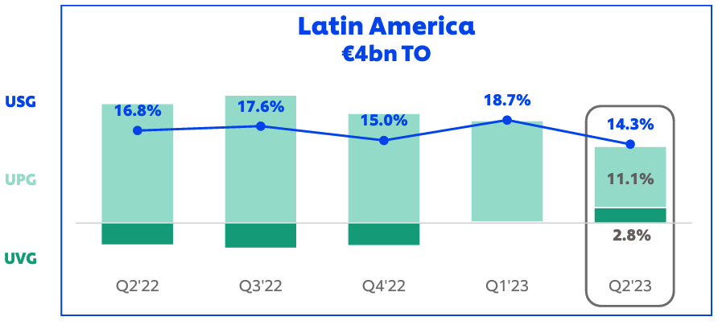
Regional growth by quarter of asian

Slide 8
Discussion
Some Unilever reports are publicly available. Can we use these report as test cases? There are lots of troubles to setup the environment on Unilever’s laptop
Searching by (year + company + section) seems too straight forward, and requires users to be familiar with the sections in the report.
Solution 1: Maybe we can still consider the previous semantic searching method with manual screenshot of tables and charts
users_input = year, company & sentences in natural language
E.g (2022, Unilever, “Show me something related to the Regional growth in Asian”)
Solution 2: Working on what we have extracted from the pdf, and provide user with (year + company + section) options (current approach)

